Slide 1

The Big Lent Swim Assembly

Slide 2

Gather
Lord I Lift Your Name on High

Slide 3
Lord, I lift your name on high,
Lord, I love to sing your praises,
I’m so glad you’re in my life,
I’m so glad you came to save us.

Slide 4
CHORUS
You came from heaven to earth to show the way,
From the earth to the cross, my debt to pay,
From the cross to the grave, from the grave to the sky,
Lord, I lift your name on high.

Slide 5
Lord, I lift your name on high,
Lord, I love to sing your praises,
I’m so glad you’re in my life,
I’m so glad you came to save us.

Slide 6
CHORUS x 2
You came from heaven to earth to show the way,
From the earth to the cross, my debt to pay,
From the cross to the grave, from the grave to the sky,
Lord, I lift your name on high.
Lord, I lift your name on high.
Lord, I lift your name on high.

Slide 7
Sign of the Cross
We begin our worship with a reminder that Jesus died and rose again for us and so we gather in the name of the Father, and of the Son, and of the Holy Spirit.
All: Amen

Slide 8
Lent explained
Lent is a time when we pray, do kind things for other people, give up things and give to others, as we prepare to celebrate the great feast of Easter. For forty days, we accompany Jesus on his journey to Calvary and we see the mercy he shows towards others, despite his suffering.

Slide 9
Just as God shows mercy towards us, like Jesus, we try to show mercy to others. So, this Lent, we will take our Lenten journey alongside families around the world living in poverty, especially those who are suffering because of climate change.

Slide 10
Opening prayer
Loving and compassionate God, teach us to show love and mercy to each other. As we begin our journey through Lent, inspire us to be generous and kind. Through our joy, patience and kindness, may we help to build a better world.
Amen.

Slide 11
Word
Scripture reading: Joel 2:12-13 Leader: Let’s listen to our scripture reading.
A reading from the prophet, Joel (2:12-13) ‘Now, now – it is the Lord who speaks – come back to me with all your heart, fasting, weeping, mourning.’ Let your hearts be broken, not your garments torn. Turn to the Lord your God again, for he is all tenderness and compassion, slow to anger, rich in graciousness, and ready to relent
The word of the Lord. All: Thanks be to God.

Slide 12
Response
In our reading, the Lord calls us to return to him with sorrow for the ways we have failed to act as we ought to have done. And God is always merciful, not wishing to punish us but to love us. Joel says, “Let your hearts be broken, not your garments torn.” In other words, let your heart be opened; it’s not about how you look on the outside, it’s all about what your heart is doing inside. God is full of love and wants us to have hearts filled with love because we have experienced his mercy.

Slide 13
The reading also asks us to fast. Fasting is one way to let God love others through us. When we fundraise for others, or give up fast food, snacks or some other treat, we stand in solidarity with people living in poverty. It’s like saying, “I want to stand beside you in your hunger”. During Lent, CAFOD invites us to support those who live in extreme poverty. CAFOD can turn the money we raise into something amazing that helps communities transform their lives. As we continue our liturgy, let’s remember our sisters and brothers living in poverty

Slide 14
CAFOD story
https://cafod.org.uk/education/primary-teaching-resources/lent-resources-for-children/big-lent-walk-resources-for-schools

Slide 15
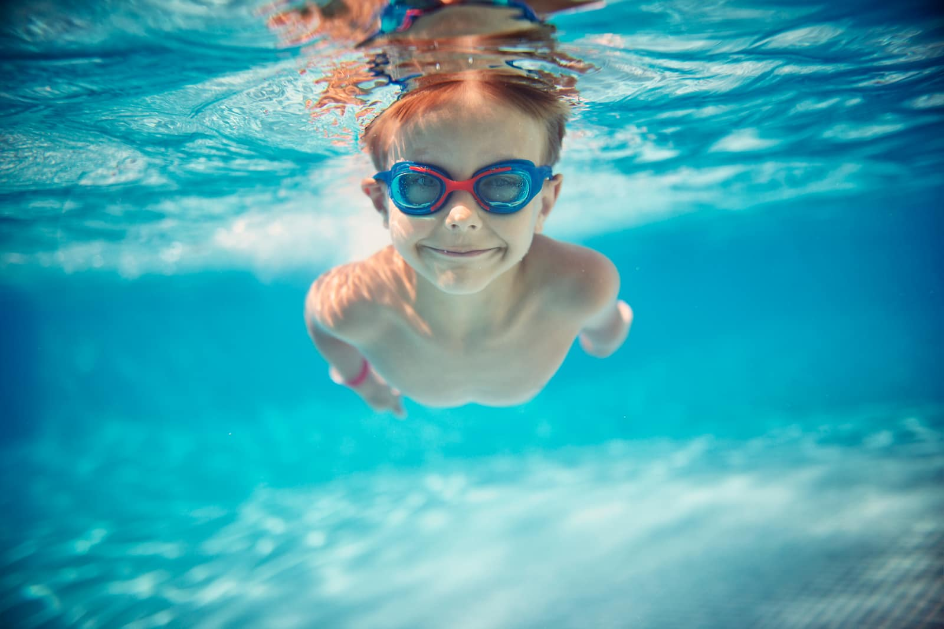
This Lent, instead of taking part in The Big Lent Walk, we will be taking part in The Big Lent Swim to show solidarity to our brothers and sisters around the world.

Slide 16
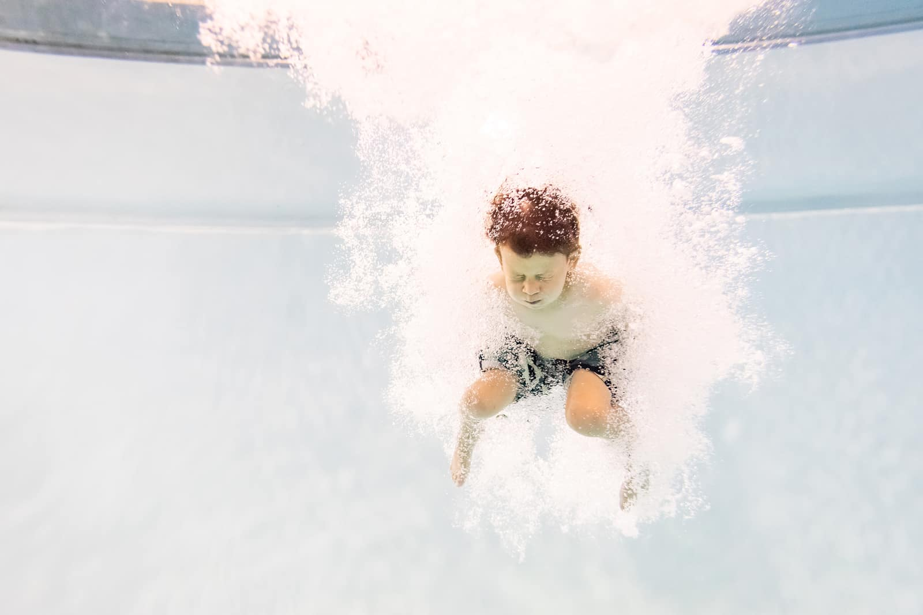
We are so lucky to have a wonderful swimming pool here at St George’s. We would like you to use our pool to raise money to provide fresh and clean water for those in the world who not have access to it.

Slide 17
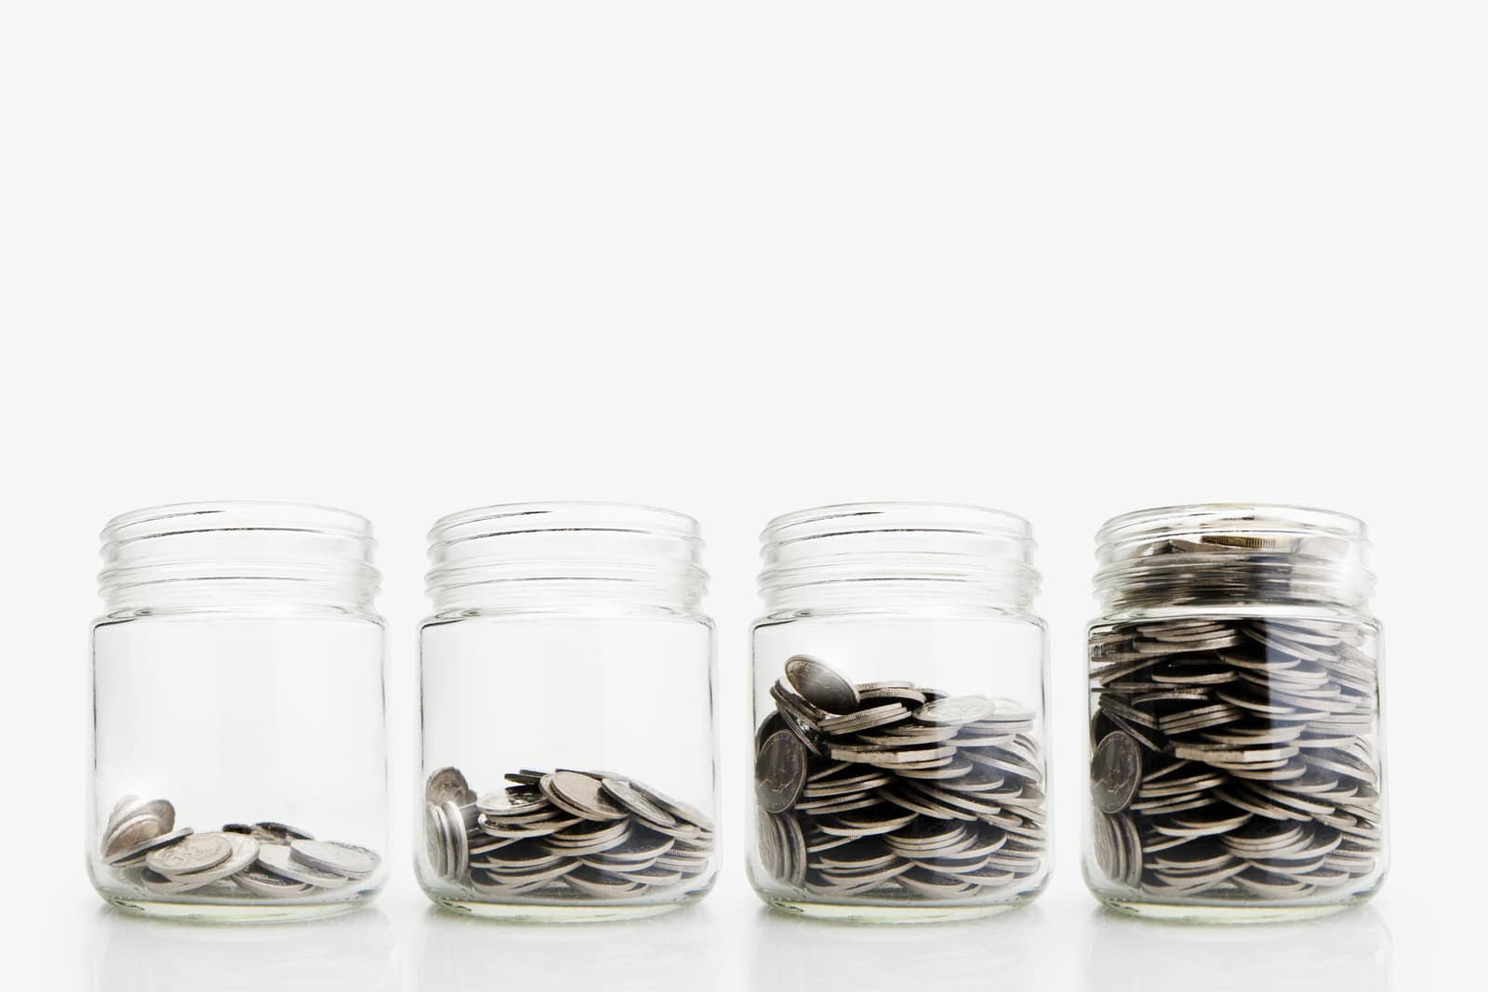
All you have to do…….
Is bring in a £1 donation to enter THE BIG LENT SWIM and then challenge yourself to swim as far as you can in every swim lesson this half term.

Slide 18

Try to keep a count of how many metres, or widths or length that you swim each session and give your total to the member of staff who supports you in the swimming pool.

Slide 19

At the end of Lent, we will total everyone’s swim record and produce a total distance swum during Lent !

Slide 20
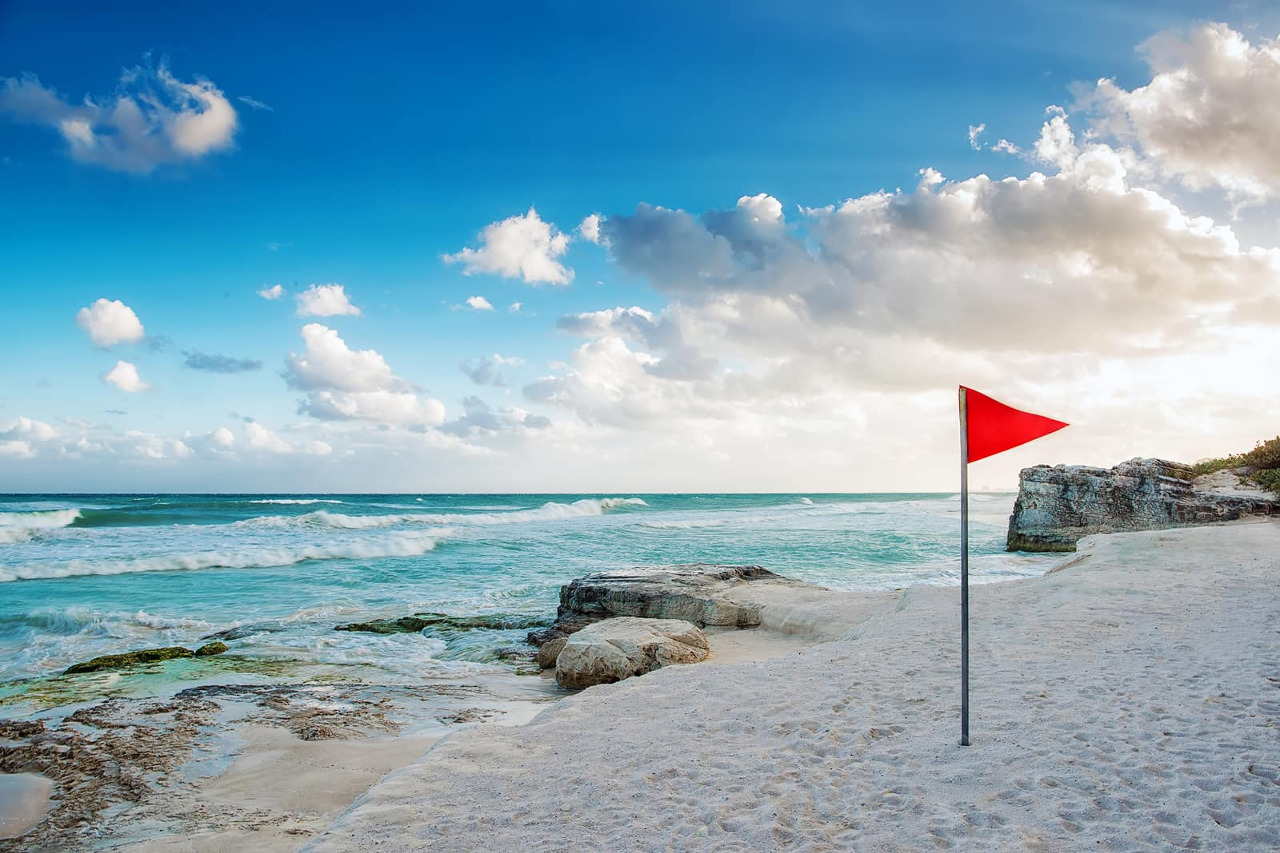
Maybe we might swim the equivalent of the English Channel ?!

Slide 21

Who wants to take part ?

Slide 22

Lenten promises
We will have a minute or two for reflection now and you are invited to write or draw your Lenten promise or a prayer for those who are experiencing poverty.

Slide 23
Please wait in silence while Class Six ,the winners of last term’s Hope Award for their attitude towards improving their leadership behaviour, place their post its in the basket and take this opportunity to speak and listen to God in your heart.
Later, Class Six will collect your prayers and promises from your classes if you wish to make them. They will be added to our CAFOD display as a sign that, this Lent, you want to help build a better world.

Slide 24
Prayers
The response is: Hear our prayer.

Slide 25
Loving God, we pray for our school family as we begin this season of Lent. Help us to be generous in our actions.
Lord, in your mercy: Hear our prayer.

Slide 26
Caring God, we pray for families who are suffering because of climate change. Through our fundraising, help us to support more families and help to build a better world.
Lord, in your mercy: Hear our prayer.

Slide 27
Gentle God, we pray for those who work for justice all over the world. As we live out our school’s Jubilee Pledge, let us never lose hope for a fair and just world.
Lord, in your mercy: Hear our prayer.

Slide 28
Wonderful God, we pray for one another as we journey through Lent. As we pray, give things up, fundraise and think of others, inspire us to be kind and show mercy in our actions.
Lord, in your mercy: Hear our prayer

Slide 29
Send
Final prayer Loving God, Help us to work together to share what we have so that everyone has what they need. Help us to build a better world where each of us can become the best person we can be. Amen Leader: In the name of the Father, and of the Son, and of the Holy Spirit.
All: Amen

Slide 30
Closing hymn
Wonderful Grace

Slide 31
Wonderful grace, that gives what I don’t deserve,
Pays me what Christ has earned, then lets me go free.
Wonderful grace, that gives me the time to change,
Washes away the stains that once covered me.

Slide 32
CHORUS
And all that I have
I lay at the feet
Of the wonderful Saviour who loves me.

Slide 33
Wonderful love, that held in the face of death,
Breathed in its latest breath forgiveness for me.
Wonderful love, whose power can break every chain,
Giving us life again, setting us free.
CHORUS x3
And all that I have I lay at the feet Of the wonderful Saviour who loves me.
(with optional harmony)

